Slide 1
Application of Machine learning algorithm in predicting force from EMG and Classification of different type of Grip Movement
Student : Hasan E. Issa
Supervised by Professor Thomas Haslwanter

Slide 2
Introduction
Relationship between daily routine Repetitive movement and repetitive strain injury (RSI) has been considered a major topic in ergonomic.
worker who may have exposure to undue physical stress strain and overexertion including vibration, awkward posture, repetitive movement could develop RSI dramatically.
Machine learning Algorithms of EMG data is a significant method to extract the important features of the EMG signal to build a statistical model can predict the exerted force by a muscle and to be able to classify different type of grip movement.
In this study we tried to build a uniform model can predict the force from collected EMG data only, and to classify three different types of grip movement. Reaching an accurate model which can implemented in an embedded EMG modality could accomplish many applications in ergonomics and Machine human interface.

Slide 3
Facts and Statistics
According to the U.S. Department of Labor, Occupational Safety and Health Administration (OSHA), repetitive strain injuries (RSI) are the nation's most common and costly occupational health problem, affecting hundreds of thousands of American workers, and costing more than $20 billion a year in workers’ compensation. According to the U.S. Bureau of Labor Statistics, nearly two-thirds of all occupational illnesses reported, were caused by exposure to repeated trauma to workers’ upper body (the wrist, elbow or shoulder). One common example of such an injury is carpal tunnel syndrome. The main problem with RSI that it can appear with occupations involving heavy labors and with computer users and typist. A simple calculation can show that if you type 40 words a minute you press 12000 keys per hour or 96,000 keys per eight-hour day, almost of 16 tons of force will be exercise by your finger. Presently, 25% of all computer operators have Carpal Tunnel Syndrome, with estimates that by the year 2000, 50% of the entire workforce may be affected. Only 23% of all Carpal Tunnel Syndrome patients were able to return to their previous professions following surgery. Up to 36% of all Carpal Tunnel Syndrome patients require unlimited medical treatment

Slide 4
Problem approach
one of the possible way to minimize the effect of RSI is to know the minimum force required to perform a certain task, such approximation can be done using a force sensor but there is a lot of limitation with using force sensor directly since such sensors need to be connected directly to the palm of the hand or need a special glove and this come with loss of real measurement scenario, another approach is to use the EMG data to measure the force by depending by the relationship between force and EMG

Slide 5
Data Measurements
Material and Method
Data acquisition and measurements are done by Richard Schmidt as part of his master thesis, this study focus in further data processing and algorithm development.
Subject
Five right-handed healthy males between 24 and 28 years with a mean of 26 years were recorded. All subjects agreed voluntarily to the participation and the publication of the recorded data.
Grip Type
Three basic everyday life grips were selected for the study: precision, force and pinch grip. Figure 1 shows the three-different grip movement.

Slide 6
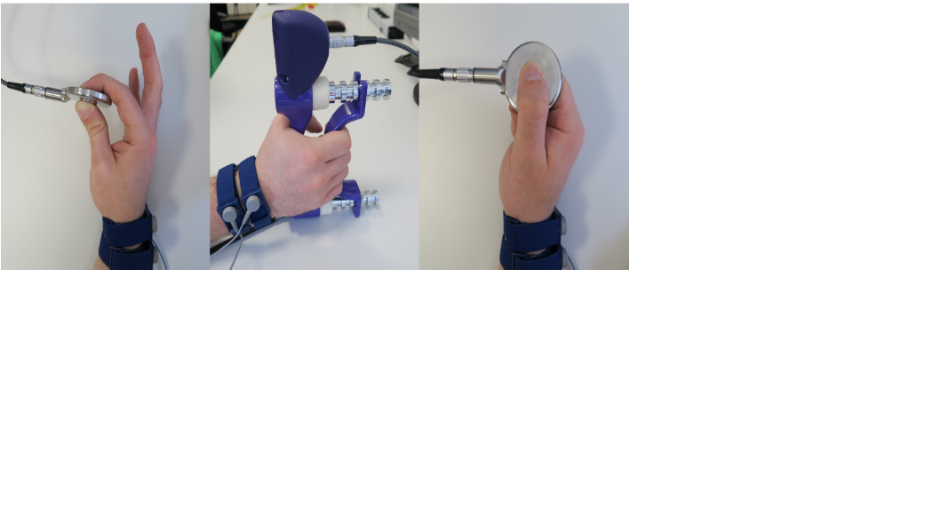
Three type of Grip Movement
Figure 1 Grip type from left to right: Precision, force, Pinch

Slide 7
Paradigm
The records consist of three identical blocks with same structure and sequence of the measurements. The only difference between each block is the grip type (pinch, force, precession), first block is the pinch grip, second is the force and third block is the precession grip, instruction for subject took around half hour before the measurement, each block took almost one hour and between each block there was a break for half hour which make the whole measurement for one subject take four hours and half.
Each block consists of 31 tasks. At the beginning and at the end of each block four calibration tasks take place. The calibration tasks were maximum force tasks
for every grip type and in addition one task with resisted maneuvers of the forearm in neutral position. Table 1 shows an overview of force and frequency tasks performed by each subject. Figure 2 shows the blocks diagram the arrows at the beginning and at the end of the block indicate the calibration tasks.

Slide 9
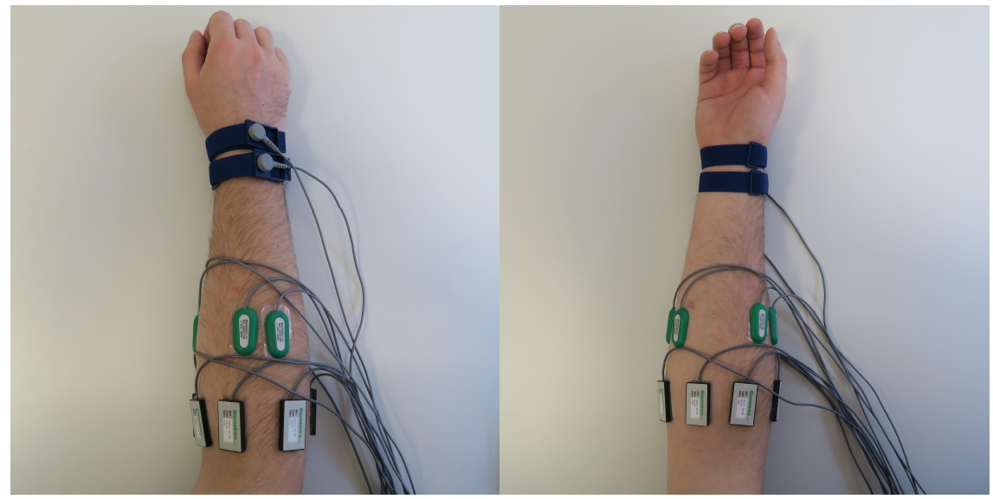
EMG Channels Configuration
To record all EMG signals the whole measurement is repeated with two different EMG electrodes configurations. The first one is six radial distributed
EMG electrodes on the forearm. The second configuration are 4 electrodes in special position on the forearm.

Slide 10
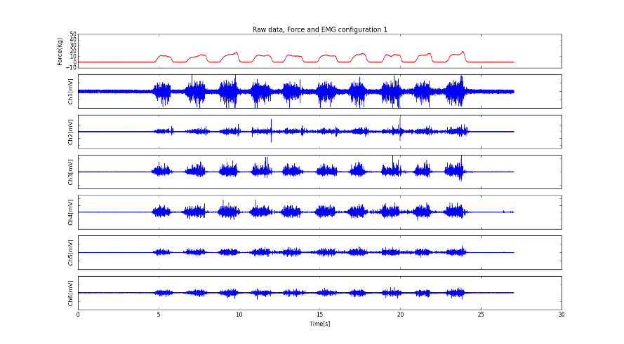
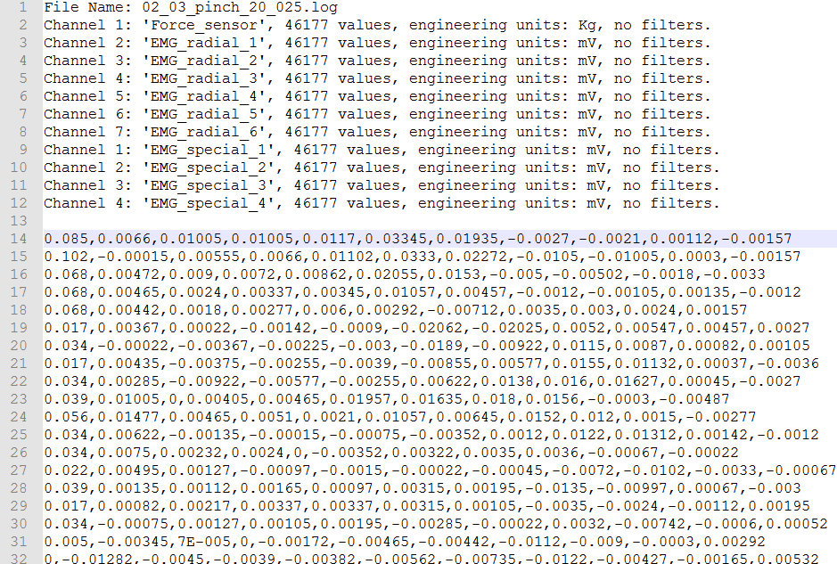
Data Processing

Slide 11
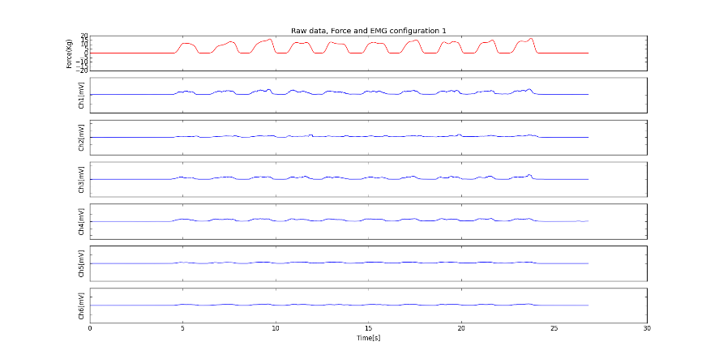
Preprocess Moving Root mean square (RMS) widow with size of 197 was used to filter the raw data, applying the RMS has been used to process EMG in much the same way as applying a linear envelope

Slide 12
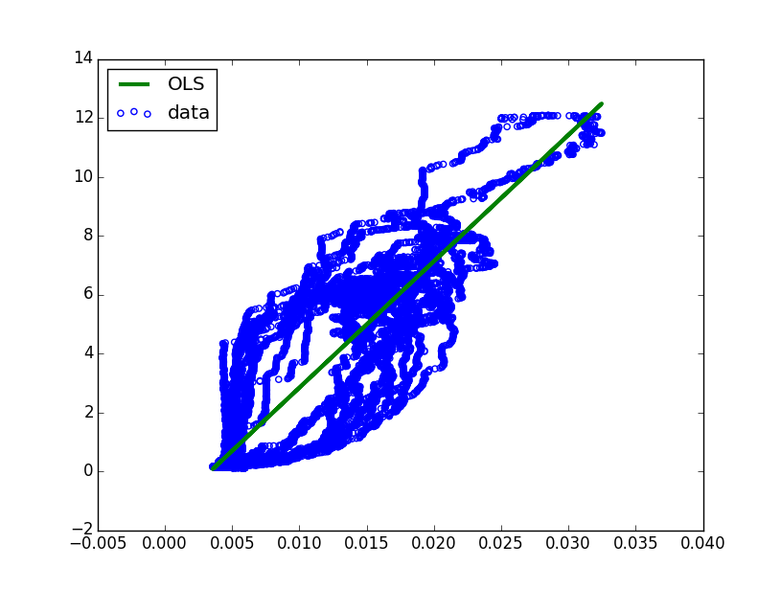
Linear Regression for a single channel
Linear Regression is a very simple approach for supervised learning. It is a useful tool for predicting a quantitative response, our first model was to build the linear regression model where the data from the force sensor is the response and the data from one electrode is the predictor. Equation [1] represent the single linear regression model
Force = β0 + β1* EMGs (1)
Sensor | Correlation coefficient
Force sensor | 1.000000
EMG_radial_1 | 0.905168
EMG_radial_2 | 0.890762
EMG_radial_3 | 0.860325
EMG_radial_4 | 0.839110
EMG_radial_5 | 0.877085
EMG_radial_6 | 0.926253
EMG_special_1 | 0.912436
EMG_special_2 | 0.902278
EMG_special_3 | 0.865208
EMG_special_4 | 0.864327

Slide 13
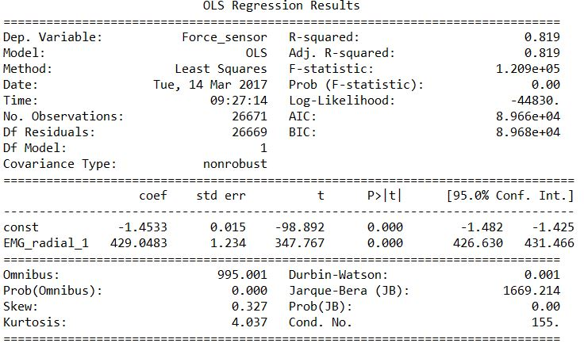
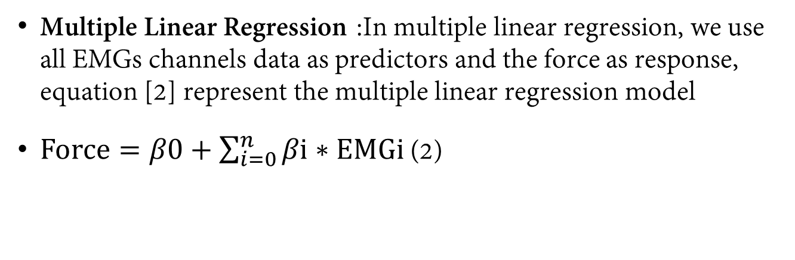
Model Estimate
Multiple Linear Regression :In multiple linear regression, we use all EMGs channels data as predictors and the force as response, equation [2] represent the multiple linear regression model
$Force=β0+\sum_{i=0}^{n}{βi∗EMGi}$ (2)

Slide 14
Force Regression
Apply root mean square filter to the raw data
Separate the contractions from the force signal by choosing a certain threshold and delete all values point below this threshold. We chose the threshold 30 % of maximum contraction.
Take the median value for each contraction
Group the median values of the contractions for each subject for a certain MVC level, in this case we will have five data sets for each grip type
Fit the data to a linear function and calculate the real intercept and slop
Estimate the model
We can estimate the model by plotting the linear fit with error of one standard deviation and three standard

Slide 15
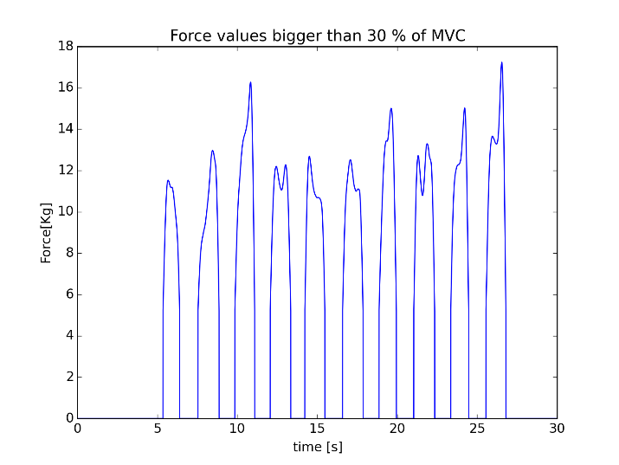
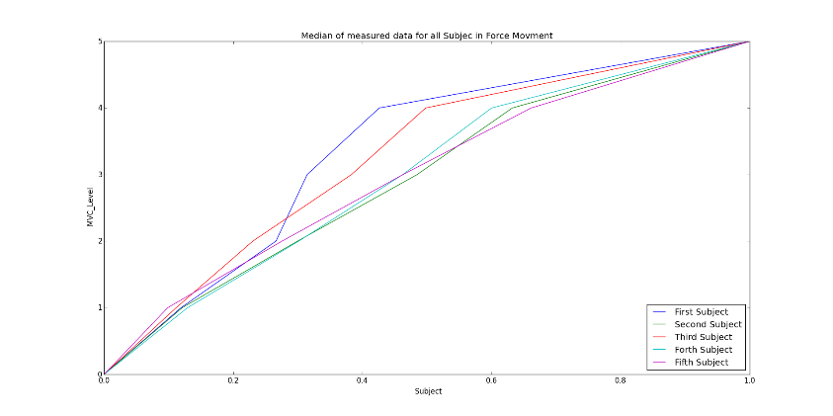

Slide 16
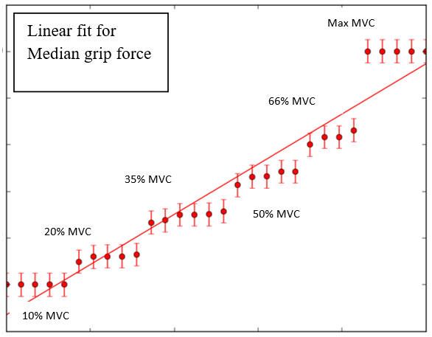
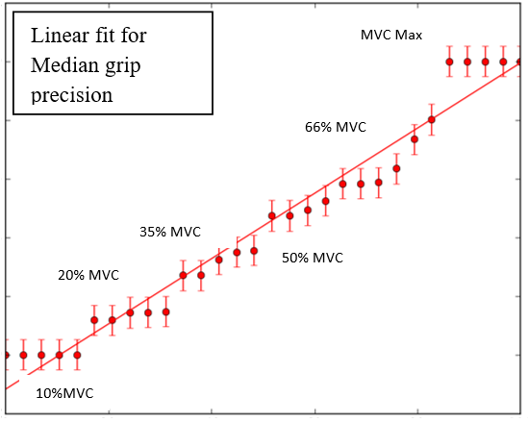

Slide 17
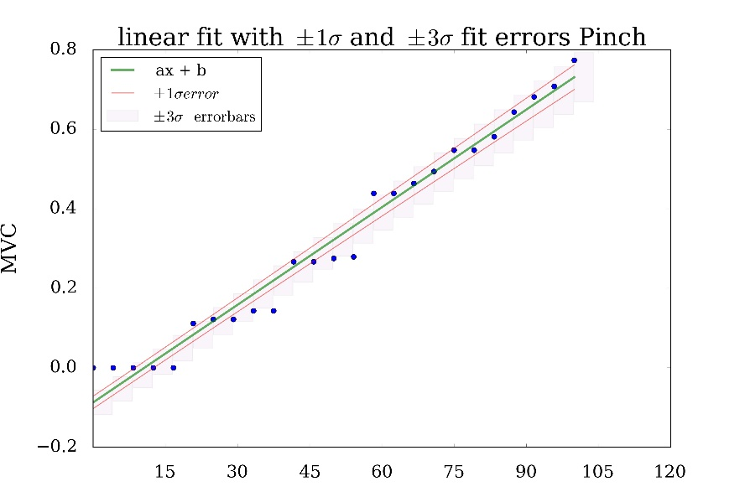
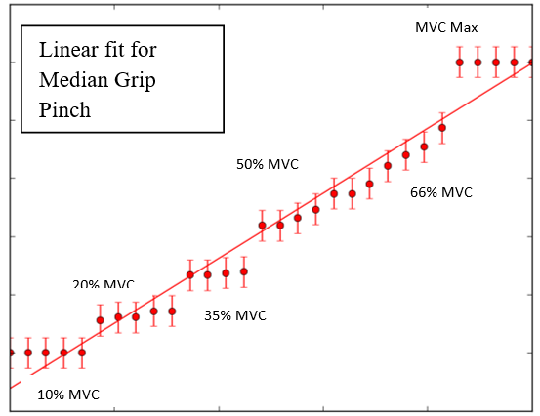

Slide 18
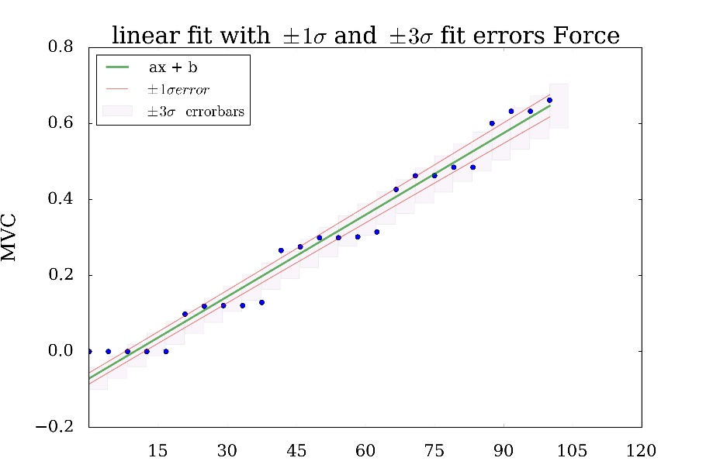
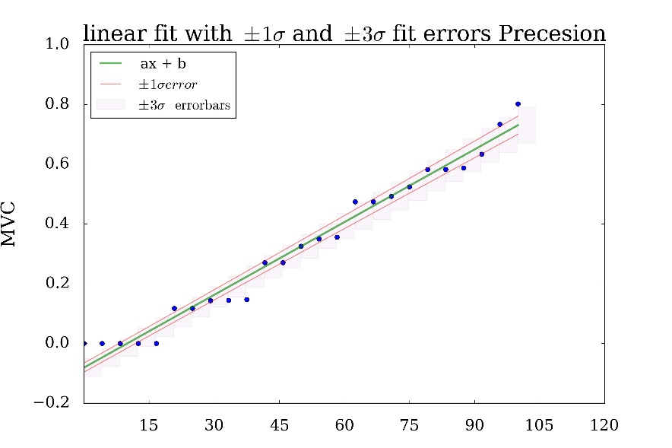

Slide 19
Conclusion
We can see that our force regression model could fit the data perfectly with acceptable error, based on this model we can predict that any contraction on certain MVC level should fit the line which describe this certain movement, the next step will be the feature extraction of the EMG signal and apply the Principal component analysis to reduce the dimensionality on multivariate data, then applying Linear discriminant analysis to reach to acceptable accuracy in grip type classification.
One of the difficulties we could find during the study is the huge amount of the data which can consume a lot of
time during application of any algorithm to a certain sub data files, one way to solve the issues is to work with guidata which is a package provide with python 3 which
can create interactive user-interface to deal with directories and drawings.
Grip type | Coefficient ax+b | Tolerance
Pinch | a = 0.011 b = -0.124 | +/- 0.0003 +/- 0.023
Precision | a = 0.011 b = -0.1182 | +/- 0.0003 +/- 0.023
Force | a = 0.39203 b = 0.001 | +/- 0.024 +/- 1.421

